Slide 1


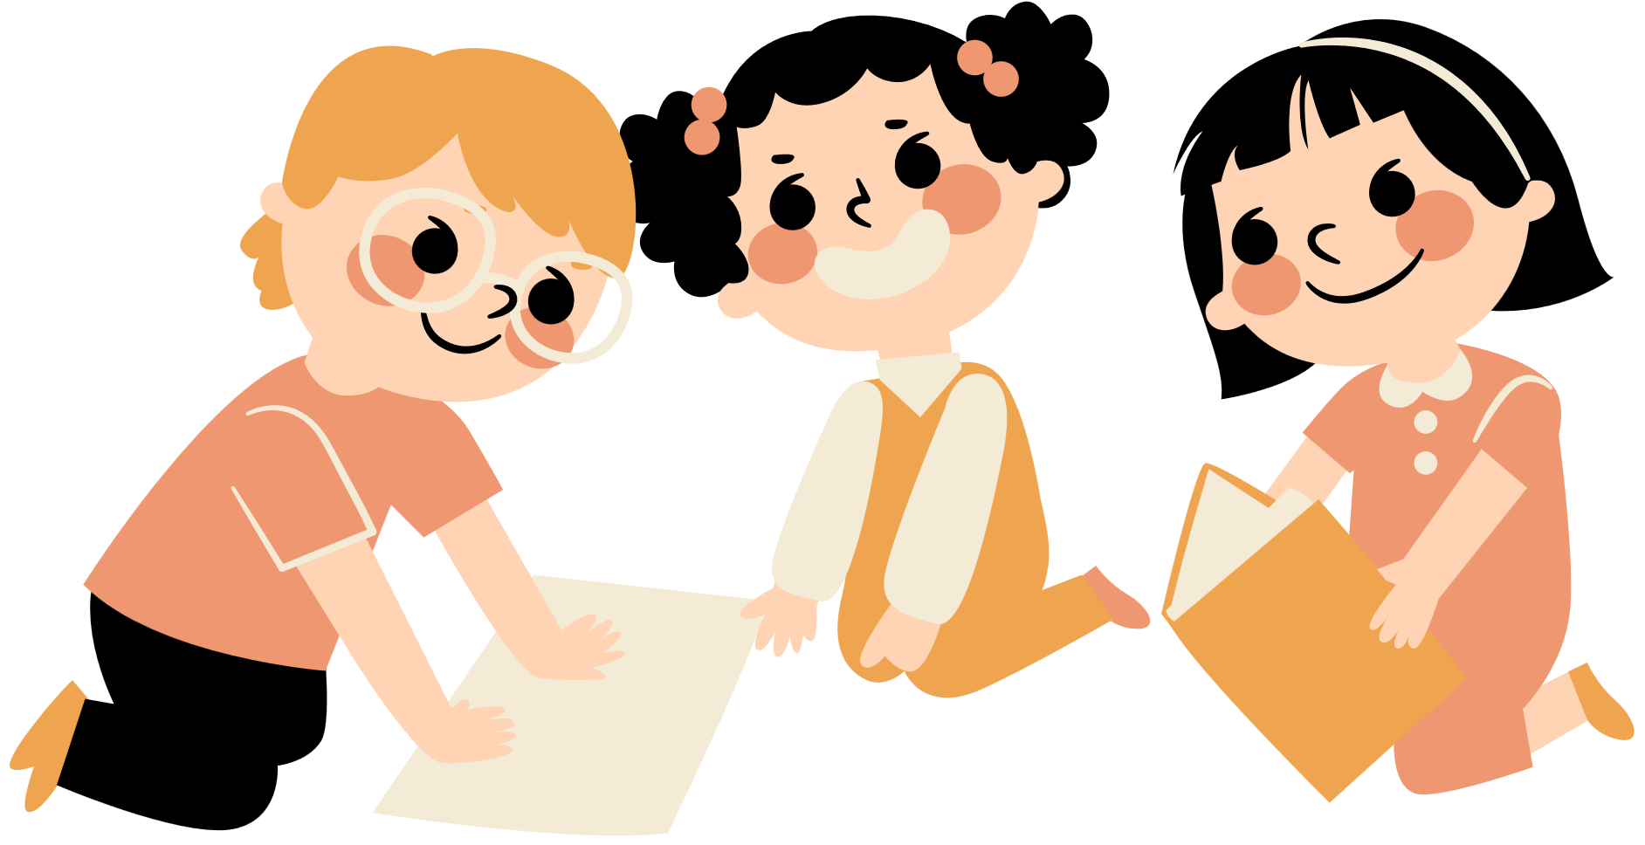
Unit 11
There’s a doll on the rug.
Lesson 1

Slide 2
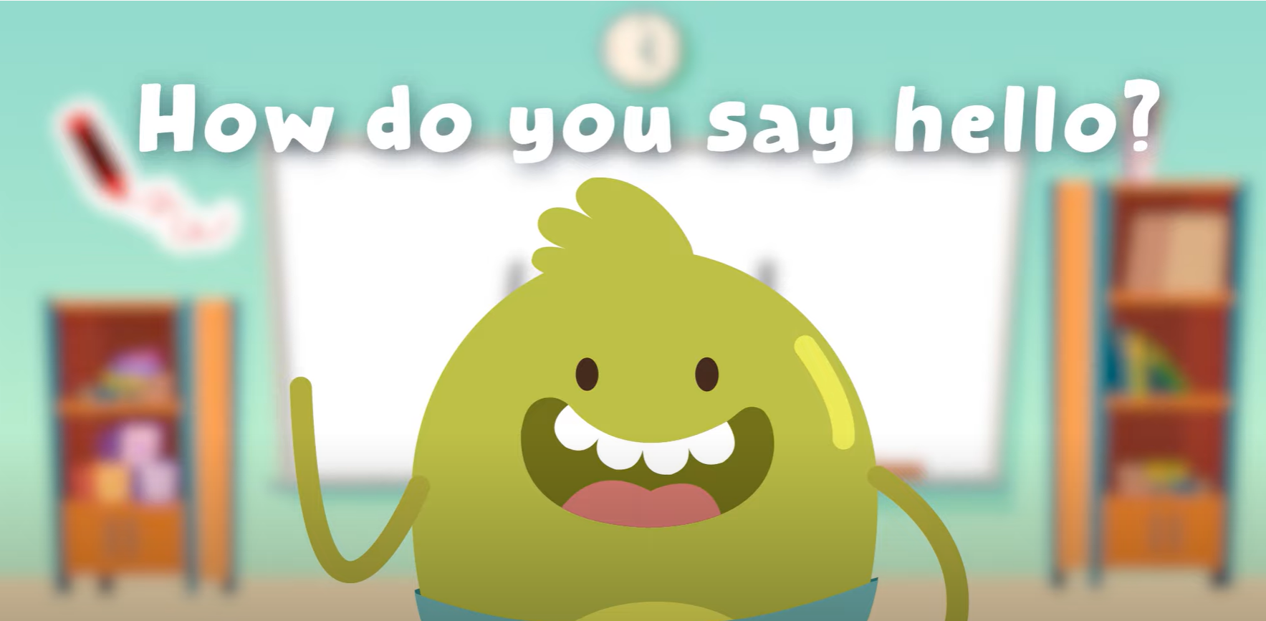
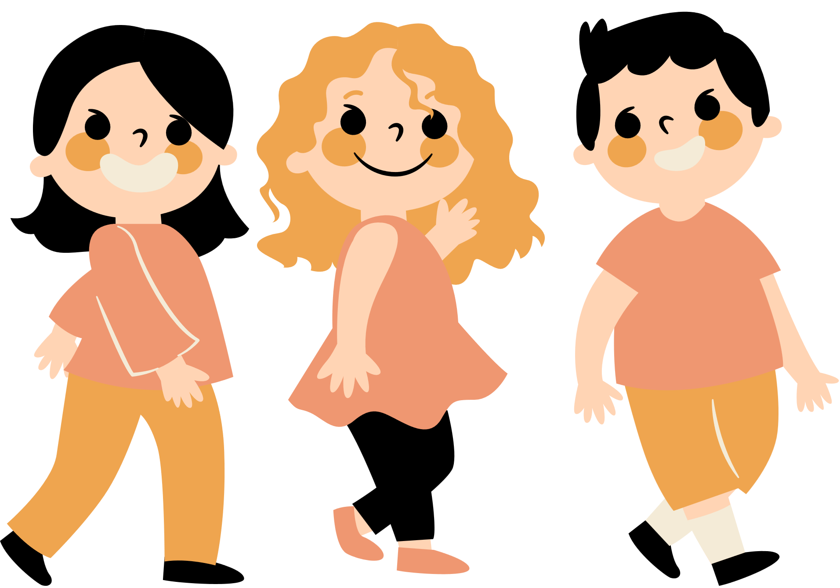
Hello song

Slide 3


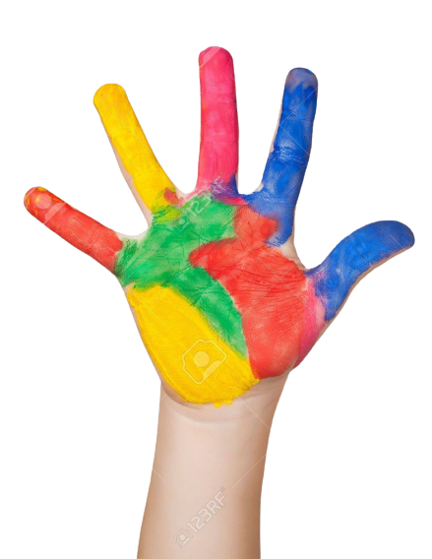



Give me Five

Slide 4
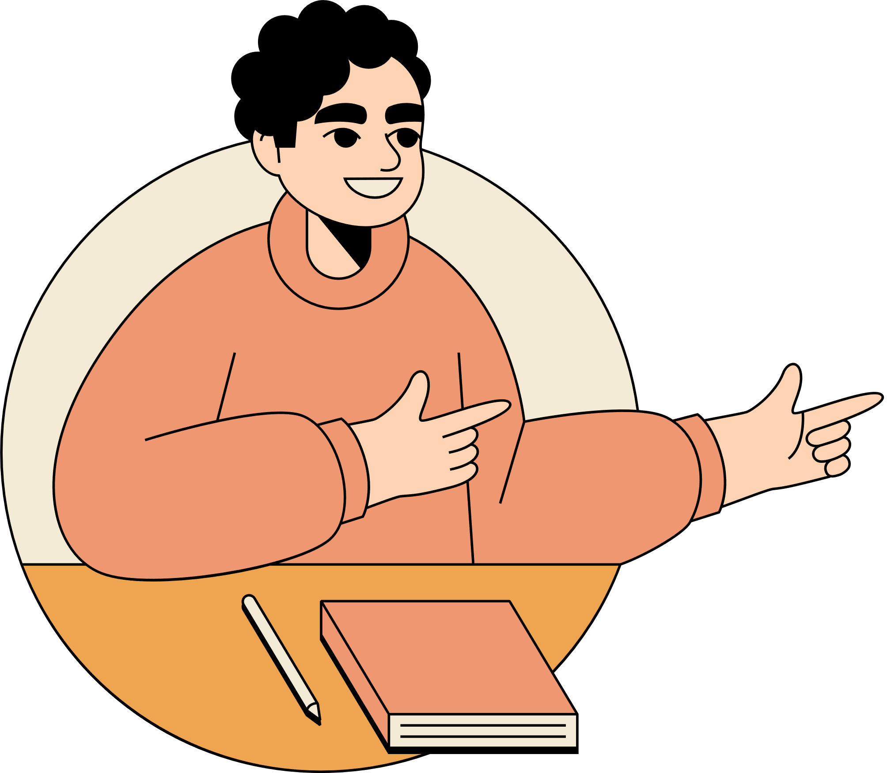
Watch and Think
Who can you see?
2. Where are they?
3. What can you see in this place?

Slide 5

Watch and Think

Slide 6
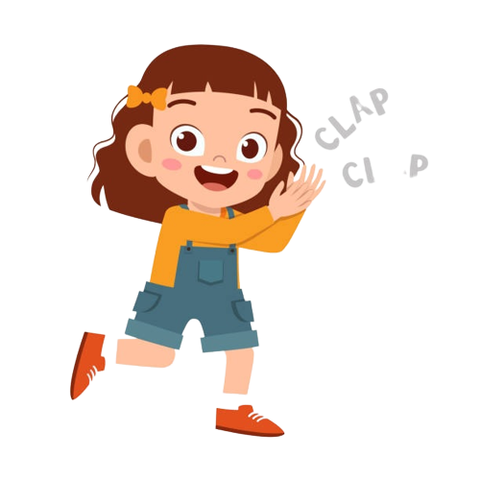
Good job!

Slide 7
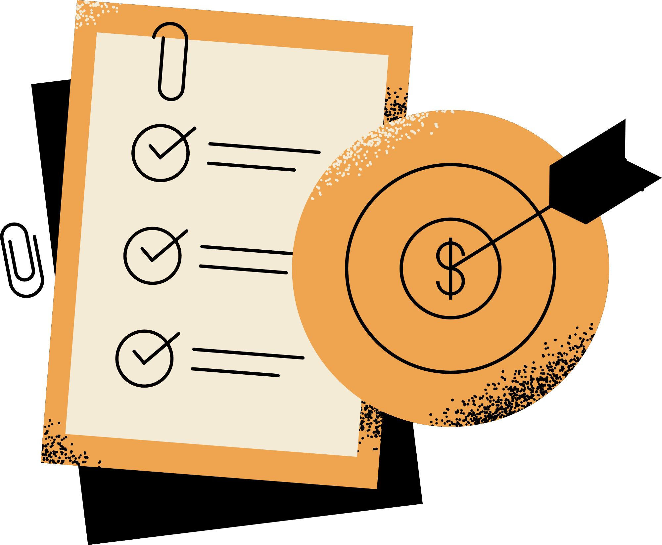

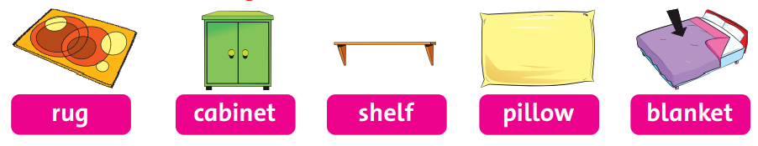

Listen
and
Point

Slide 8
Listen
and
Chant

Slide 9


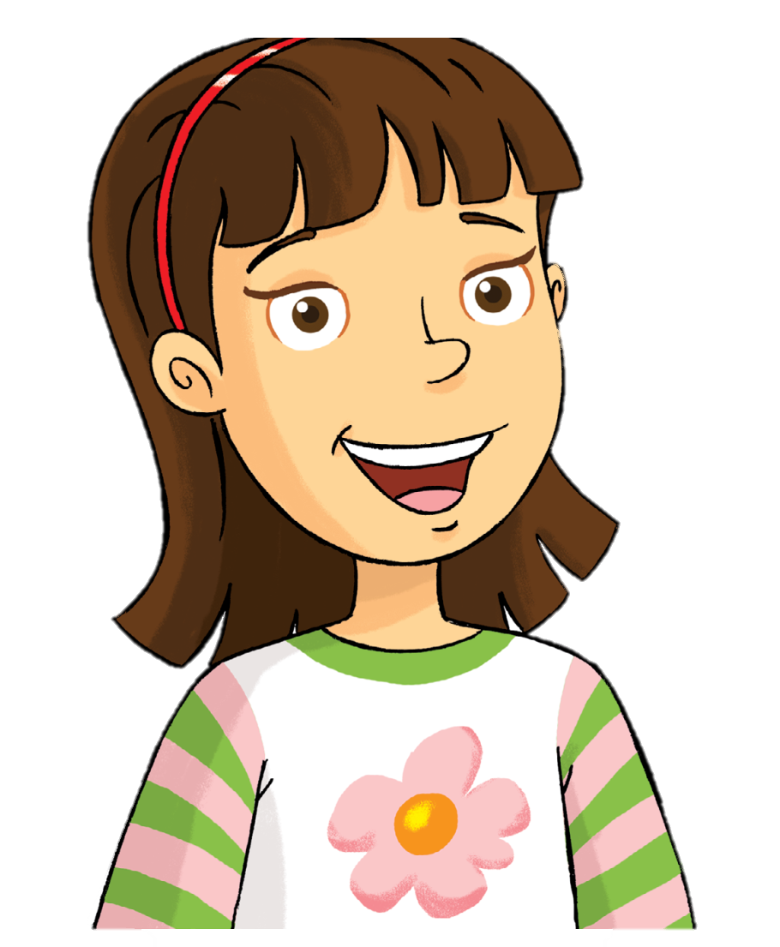
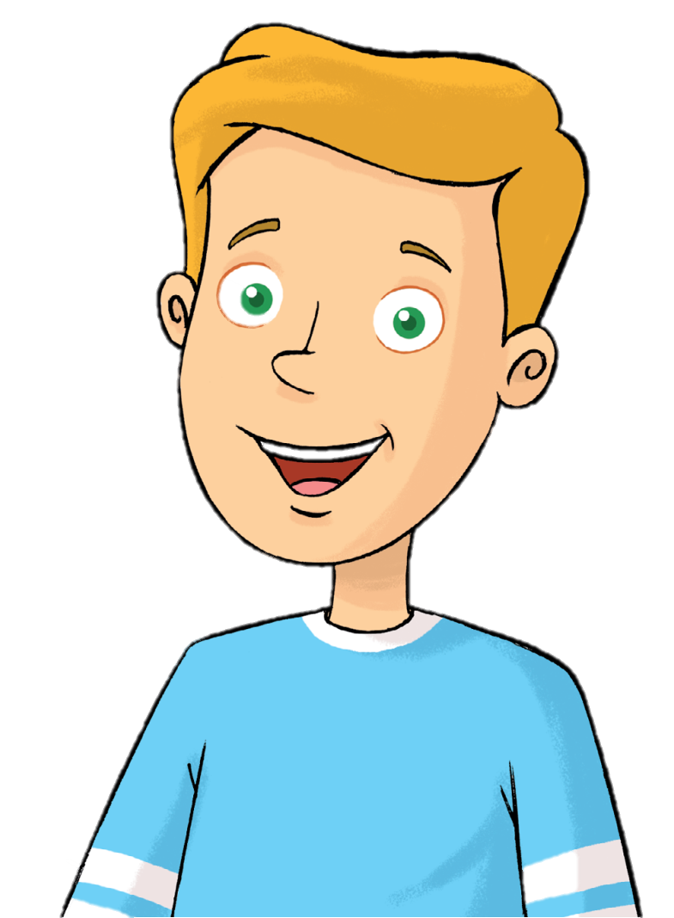
Who’s this?
Rosy
Tim

Slide 10

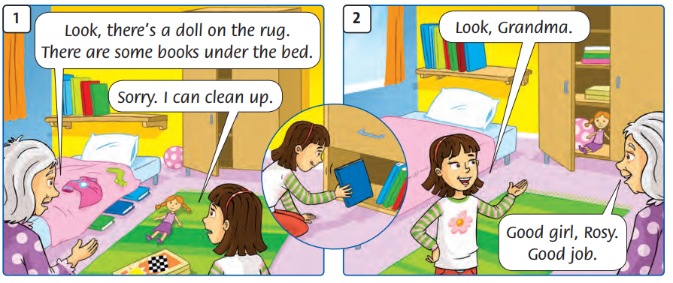
What’s happening?

Slide 11
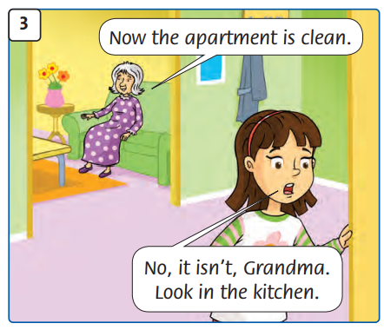
What’s happening?

Slide 12
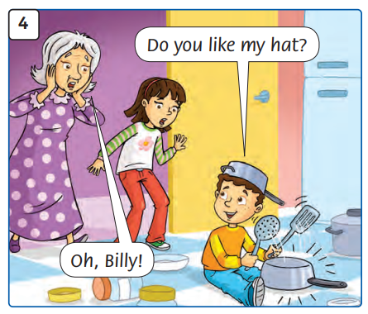
What’s happening?

Slide 13
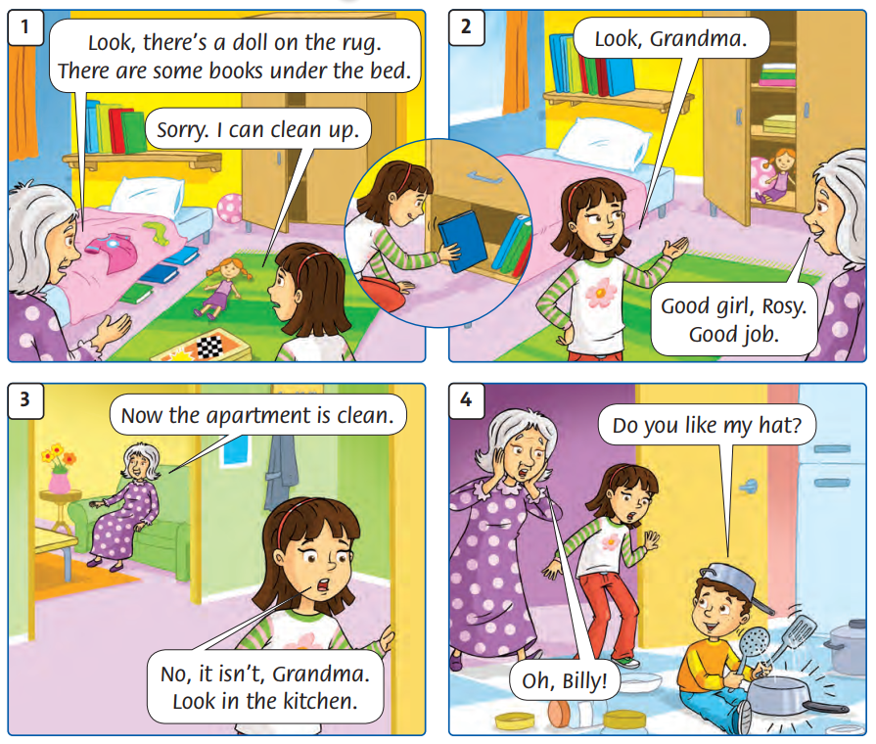
Listen and Point

Slide 14
Listen and Repeat

Slide 15
Good job!

Slide 16
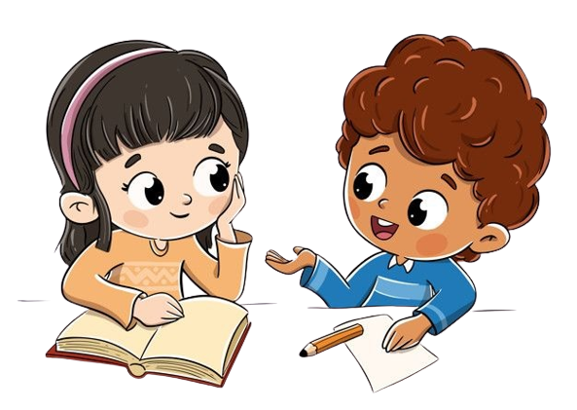

Work in groups
Role-Play

Slide 17
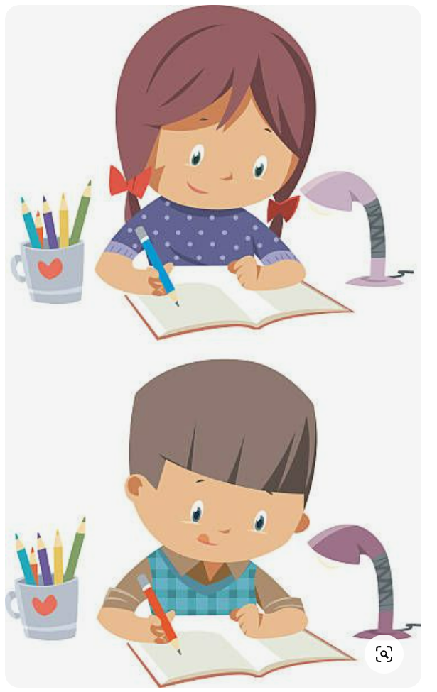
Homework

Slide 18

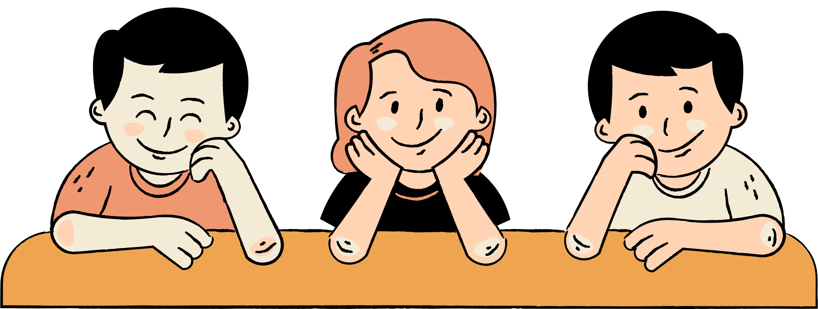
Thank You

